Slide 1
BITS Pilani
Prof.Aruna Malapati
Department of CSIS

Slide 2
Neural Word Embeddings

Slide 3
Today’s Agenda
Neural Embeddings
Skip gram Model
Continuous Bag of Words Model

Slide 4
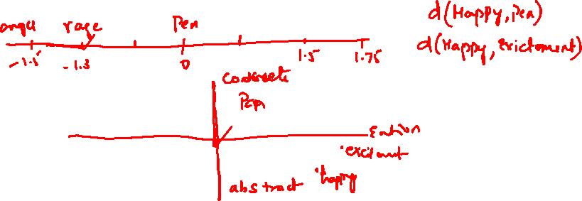


Neural Word Embeddings
A word embedding is a numerical representation of a word.
These vectors carry the meaning of the word or embed meaning and are of low dimensions.

Slide 5
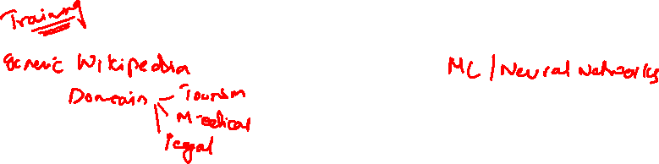
Two ingredients for generating word embeddings
Corpus
Embedding Method

Slide 6
Word embedding methods
Word2Vec
Global Vectors (Glove)
FastText
BERT
ELMO
GPT-2

Slide 7
The word representations computed using neural networks are very interesting because the learned vectors explicitly encode many linguistic regularities and patterns. Somewhat surprisingly, many of these patterns can be represented as linear translations.
For example, the result of a vector calculation
vec(“Madrid”) - vec(“Spain”) + vec(“France”) is closer to vec(“Paris”) than to any other word vector [9, 8].
https://arxiv.org/pdf/1310.4546.pdf

Slide 8
Skipgram Model
A word can be used to predict its surrounding words in a text corpus
Given a center word it tries to predict the conditional probability of the neighboring words and further maximize the probability of occurrence.
The quick brown fox jumped on the lazy dog
Training data assuming a window size of 1
{ <The,quick>, <quick,The>, <quick,brown>,<brown,quick>,<brown,fox>,
<fox,brown>,<fox,jumped>,<jumped,fox>}

Slide 9

































Skipgram Model (Contd..)

Slide 10



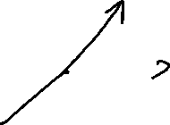


















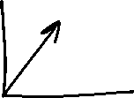














Skipgram Model (Contd..)

Slide 11



















Skipgram Model (Contd..)

Slide 12











































Objective function

Slide 13
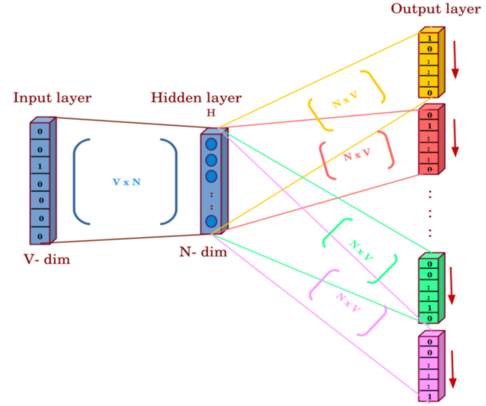





Skip-gram Neural architecture
One hot encoding
Of the Centre word (V_{c})
One hot encoding
of the Context words (U_{o})

Slide 14
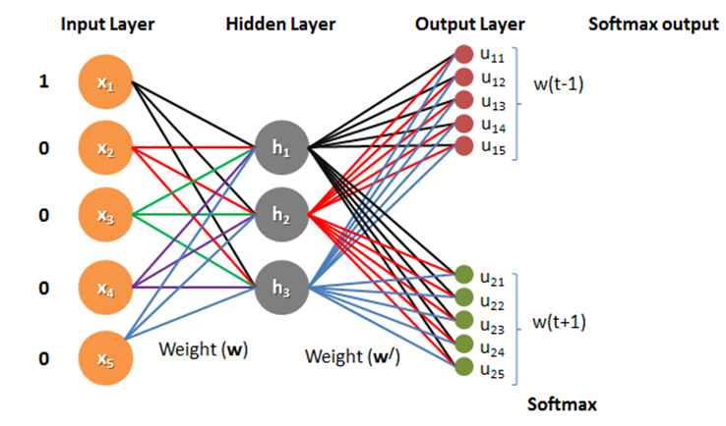





Skip-gram Neural architecture

Slide 15




































Forward Propagation

Slide 16
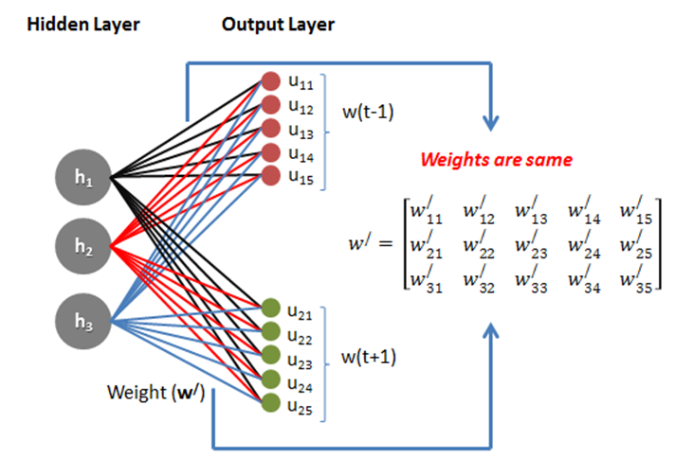

Skip-gram Neural architecture

Slide 17
Example – forward propagation
Input word one hot encoding
Initial weight matrix for center words
x1 | the | 0
x2 | quick | 1
x3 | brown | 0
x4 | fox | 0
x5 | jumps | 0
x6 | over | 0
x7 | lazy | 0
x8 | dog | 0
-0.78 | 0.018 | 0.033
0.068 | 0.17 | -0.109
-0.158 | -0.081 | -0.151
0.15 | 0.064 | 0.145
-0.097 | -0.055 | 0.188
0.036 | 0.071 | 0.059
0.168 | -0.06 | -0.58
0.098 | 0.015 | 0.096
Hidden Layer
0.068
0.17
-0.109
X
=
0.128
0.125
0.124
0.124
0.122
0.127
0.13
0.12
Sum=1
Initial weight matrix for context words
0.042
0.2
0.006
0.007
-0.005
0.03
0.052
-0.021
0.192 | 0.176 | 0.012
0.07 | 0.061 | -0.046
-0.066 | 0.117 | 0.083
0.014 | 0.006 | -0.044
-0.012 | 0.067 | 0.147
0.013 | 0.111 | -0.097
0.016 | 0.175 | -0.198
-0.028 | -0.016 | 0.148
Hidden Layer
0.068
0.17
-0.109
X
=
Softmax

Slide 18
Example-Backward Propagation: Sum of Prediction Errors
C different prediction errors are computed, then summed up. For simplicity let the window size be 1. In which case we are trying to predict two words.
Y-Pred
Y-true
Error_the
Error_brown
Error_Sum
Y-Pred
Y-true
0.128
0.125
0.124
0.124
0.122
0.127
0.130
0.120
the | 1
quick | 0
brown | 0
fox | 0
jumps | 0
over | 0
lazy | 0
dog | 0
-0.872
0.125
0.124
0.124
0.122
0.127
0.130
0.120
the | 0
quick | 0
brown | 1
fox | 0
jumps | 0
over | 0
lazy | 0
dog | 0
0.128
0.125
-0.876
0.124
0.122
0.127
0.130
0.120
-0.744
0.25
-0.752
0.248
0.244
0.254
0.26
0.24
0.128
0.125
0.124
0.124
0.122
0.127
0.130
0.120
+
=
Notes:
Error=Y-Pred-Y-True

Slide 19
Loss
Machine Learning
Model
Predicted context
word vector
Center word
Pred
Truth
Parameters
W and W’
Minimize
Loss=Pred-Truth
Adjust
Error
Notes:
The objective of the learning process is to find the parameters that minimize the loss given the training examples.

Slide 20
Hyper parameters
Dimensionality: dimensions of the word vectors
Window Size: how big of a window you want around the center word
Minimum Count: how many times a word has to appear in the corpus for it to be assigned a vector (if a word happens too few times, it is difficult to assign it a good vector)
ModelType: skip-gram or continuous bag-of-words
Number of Iterations: number of iterations (epochs) over the corpus

Slide 21
Extension to Skipgram
Subsampling frequent words to decrease number of training examples
Modify the objective function with Negative Sampling

Slide 22
Continuous Bag Of Words(CBOW)
The objective of this model is to predict a missing word based on the surrounding words.
The idea is that if two unique words are frequently surrounded by similar set of words in various sentences then the two words are semantically similar.
For example “The little ____ is barking”

Slide 23
Training data
Center Word
The quick brown fox jumps over the lazy dog.
Context Words
C=2
Window size=5
Training Examples
Context words (Input) Center Word(output)
The quick fox jumps brown
quick brown jumps over fox
brown fox over the jumps
fox jumps the lazy over

Slide 24
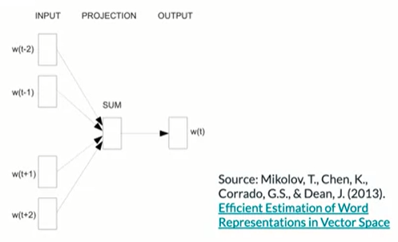
Continuous Bag Of Words(CBOW)

Slide 25
Converting center words and context words into vectors
The quick brown fox jumps over the lazy dog.
Vocabulary = brown,dog,fox,jumps,lazy,over,quick,the}
Center words will be one hot encoded
Context words will be average of one hot vectors
brown | 1
dog | 0
fox | 0
jumps | 0
lazy | 0
over | 0
quick | 0
the | 0
brown | 1
dog | 0
fox | 0
jumps | 0
lazy | 0
over | 0
quick | 0
the | 1
brown | 0
dog | 0
fox | 0
jumps | 0
lazy | 0
over | 0
quick | 1
the | 0
brown | 0
dog | 0
fox | 1
jumps | 0
lazy | 0
over | 0
quick | 0
the | 0
brown | 0
dog | 0
fox | 0
jumps | 1
lazy | 0
over | 0
quick | 0
the | 0
0.25
0
0.25
0.25
0
0
0.25
0.25
+
+
+
=
The quick fox jumps

Slide 26
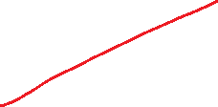







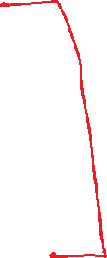












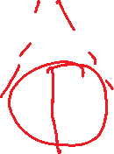





Architecture of CBOW
Notes:
It consists of a shallow dense network.

Slide 27

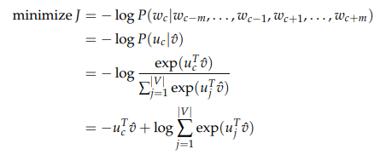
Cross entropy loss function
Cross-entropy loss, or log loss, measures the performance of a classification model whose output is a probability value between 0 and 1.
Notes:
Cross-entropy loss, or log loss, measures the performance of a classification model whose output is a probability value between 0 and 1. Cross-entropy loss increases as the predicted probability diverges from the actual label. So predicting a probability of .012 when the actual observation label is 1 would be bad and result in a high loss value. A perfect model would have a log loss of 0.

Slide 28
Summary
Word2Vec neural models are trained on a generic corpus.
Skipgram and CBOW are two approaches for generating the word embeddings

Slide 29
Other Work on Word Embeddings
Active research area
Using sub word information (e.g. characters) in the word embeddings
Tailoring embeddings for different NLP tasks

